Slide 1
MISSIONS IN THE METAVERSE: RECONCILING HUMANITY WITH THEIR CREATOR BY REACHING THEM WHERE THEY LIVE, ON THEIR DEVICES, VIA DIGITAL MISSIONS
www.SpiritualWarfare.blog/digital-missions
Dr. Jonathan Carl

Slide 2
Thesis:
The Metaverse is less about virtual reality and more about the increasing reality of people living (time spent communicating and connecting) in digital places.
Christians have the imperative and opportunity to increasingly enter the digital realm in order to effectively reach and teach souls with Jesus’ Scriptural truth and love.

Slide 3
Why Digital Missions?
The Biblical Foundations & Imperatives www.SpiritualWarfare.blog/digital-missions-scriptures

Slide 4
Are digital mission strategies a biblical approach to reconciliation?
We must consider whether reconciliation can genuinely occur through digital media and platforms.
Paul’s epistles are a particularly helpful example when evaluating the means and prioritization of digital missions and digital missionaries.

Slide 5
Digital missions – a scriptural survey
COMMUNICATION & CONNECTION
2 Corinthians 5:18–20 “All this is from God, who through Christ reconciled us to himself and gave us the ministry of reconciliation; that is, in Christ God was reconciling the world to himself, not counting their trespasses against them, and entrusting to us the message of reconciliation. Therefore, we are ambassadors for Christ, God making his appeal through us. We implore you on behalf of Christ, be reconciled to God.” (ESV)

Slide 6
Digital missions – a scriptural survey
Colossians 2:5 “For though I am absent in body, yet I am with you in spirit, rejoicing to see your good order and the firmness of your faith in Christ.”
1 Thessalonians 2:17–18 “But since we were torn away from you, brothers, for a short time, in person not in heart, we endeavored the more eagerly and with great desire to see you face to face, because we wanted to come to you—I, Paul, again and again—but Satan hindered us.” (ESV)

Slide 7
Communication
The Scriptures are a sufficient source of communication for salvation and disciple-making.
The Scriptures can be communicated in-person or by other mediums of communication.
The church can communicate the Gospel and teach the Scriptures digitally but cannot fully function as the body of Christ solely in the digital realm.
www.trustworthyword.com/online-church

Slide 8
connection
Missionaries can accomplish many evangelistic, discipleship, and missional tasks in the digital realm.
Connections in the digital realm are real spiritual, mental, and emotional connections even without a physical presence.

Slide 9
Why Digital Missions?
The Statistical Realities & Opportunities
www.SpiritualWarfare.blog/missions-statistics
What to Do in Digital Missions: Understanding the Digital Realm
www.SpiritualWarfare.blog/digital-missions-research

Slide 10
The Statistics: The DIGITAL Missions Imperative
Christian organizations have often lagged behind society in adapting to technological changes and missed out on key opportunities for gospel reach. The history of Christian missions demonstrates an ever-present urgency to go to the lost wherever they live. Increasingly, the lost “live” on their digital devices.
Christian missionaries must “go” to the lost on their devices, obtaining a fraction of their screen-time attention for the sake of their souls. This paper will share the statistical developments to demonstrate the importance of understanding the evolving digital age of the metaverse.

Slide 11
How many souls are extremely difficult to reach & teach in-person?
At least 5.5 billion.
There are 7.83 billion people in the world
Some 65-70% of the world's population live in religiously restrictive countries.
Some restrictions result from government actions, policies and laws. Others result from hostile acts by private individuals, organizations and social groups.

Slide 13
The Statistics: The DIGITAL Missions Imperative
90% of foreign missionaries work among already reached people groups. 10% work among unreached people groups. (Winter and Koch, 543)
91% of all Christian outreach/evangelism does not target non-Christians, but targets other Christians. (Baxter 2007, 12)
There are 140,000 recorded protestant missionaries serving in the world, with 64,000 from the US. (The Traveling Team)

Slide 14
The Statistics: The DIGITAL Missions Imperative
MISSIONARIES PER RELIGION: (The Traveling Team)
Tribals – 714,108,000 population with 11,900 Missionaries: 1 for every 60,000
Hindus – 984,532,000 population with 5,500 Missionaries: 1 for every 179,000
Unreligious – 831,267,000 population with 11,700 Missionaries: 1 for every 71,000
Muslims – 1,703,146,000 population with 4,200 Missionaries: 1 for every 405,500
Buddhists – 520,002,000 population with 2,000 Missionaries: 1 for every 260,000

Slide 15
The Statistics: The DIGITAL Missions OPPORTUNITY
Fully 89% of parents of a child age 5 to 11 say their child watches videos on YouTube
Nearly all Americans – 97% – now own a cellphone of some kind.
Nearly all Japanese under 35 own a smartphone (96%)
US smartphone use is now 85%, up from just 35% in Pew Research Center’s first survey of smartphone ownership conducted in 2011 (Pew Research Mobile 2021)

Slide 17
The Statistics: The DIGITAL Missions OPPORTUNITY
7.69 billion smartphone subscriptions worldwide by 2027 (O’Dea 2022)
Internet use is nearly universal in most advanced economies surveyed. … in emerging economies, about half or more use the internet in every country but India. (Silver 2019).
screen time outside of virtual school among teenagers doubled from pre-pandemic estimates of 3.8 hours per day to 7.7 hours. (Rodriguez 2021)
50% of US Residents Spend Most of the Day on Screens (Koetsier 2020)

Slide 18
The Statistics: The DIGITAL Missions OPPORTUNITY
Average daily time spent consuming content is now six hours and 59 minutes, which includes phone, TV, and other forms of digital media. (Koetsier 2020)
45% of US teens say they are “almost constantly” on the internet (Schaeffer 2019)
Those 60 and older – a group increasingly populated by aging Baby Boomers – now spend more than half of their daily leisure time, four hours and 16 minutes, in front of screens, mostly watching TV or videos. … about half (53%) of people 65 and older are smartphone owners (Livingston 2019)

Slide 19
The Statistics: The DIGITAL Missions OPPORTUNITY
Worldwide, the average person spends 2 hours and 25 minutes on social media each day (Moody 2021)
In the Philippines, where screen-time consumption is the highest in the world, the majority of this (almost 6 hours) is on mobiles. Brazilians also favor mobile screens (spending 5 hours and 17 minutes a day looking at them) as do the Thais (spending 5 hours and 7 minutes a day looking at them). (Moody 2021)
Average mobile internet speed 42.7Mbps, fixed 96.43Mbps (Moody 2021)

Slide 20
The Statistics: The DIGITAL Missions OPPORTUNITY
6:55 on devices, 3:39 on mobiles, 3:16 on computer (Moody 2021)
59.5% of population using internet (Moody 2021)
Physical spaces and virtual spaces will be seamlessly integrated, and digital technologies will disappear so completely into our lives and surrounding environments that we will barely notice it. Some call it a “metaverse,” but it has several meanings and manifestations to different experts. (Anderson and Rainie 2022)

Slide 21
What to Do in Digital Missions: Understanding the Digital Realm
Morpheus in the Matrix – “you can’t explain what the Matrix [Metaverse] is, you have to experience it for yourself” (Nieuwhof CNLP470 2022)
“A missionary is nothing more than a disciple of Jesus, who makes disciples of Jesus, where Jesus is not known yet.” Zane Pratt, VP Global Training to the IMB
Barry Chudakov predicts “the self will go digital” and exist in the flesh and in its digital avatar. “Identity is thereby multiple and fluid: Roles, sexual orientation and self-presentation evolve from solely in-person to in-space.” (Anderson & Rainie 2021)

Slide 22
What to Do in Digital Missions: Understanding the Digital Realm
The Internet – Email, Websites
Social Media
Web3/Metaverse – Virtual and Augmented Realities
Games, Entertainment, Events, Social Interactions, Work, Education, Exercise
The Metaverse is less about virtual reality and more about the increasing reality of people living (time spent communicating and connecting) in digital places.

Slide 23
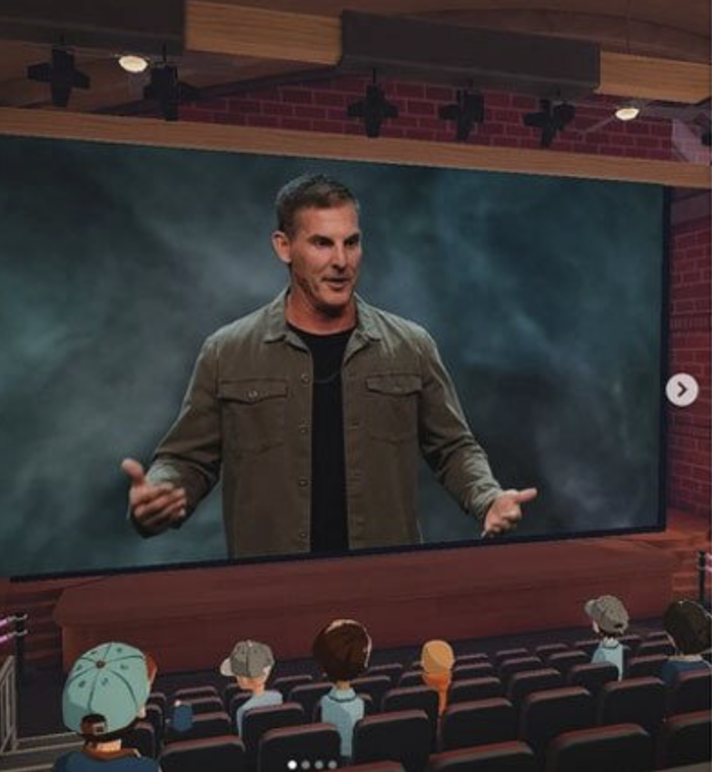
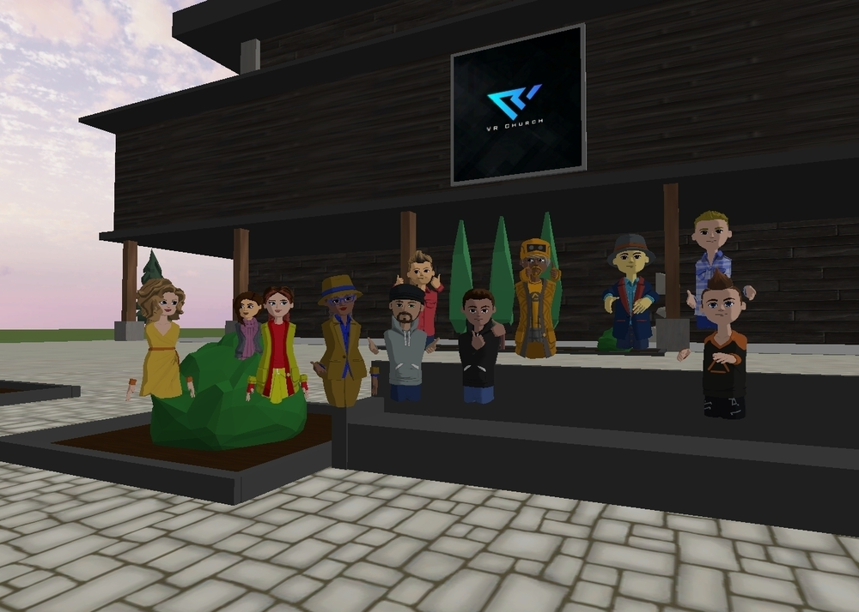
What to Do in Digital Missions: Understanding the Digital Realm
Current Approaches: VR Church, Life.Church
Oculus & Future Technologies

Slide 24
How to Do Digital Missions: Urgent Next Steps for Reconciling Humanity with their Creator
Modern day military warfare has increasingly found avenues of offense and defense in an evolving era of “cyber warfare.” Satan has modeled spiritual cyber warfare by effectively utilizing digital strategies both to enslave the lost and to impede the saints’ approaches to evangelism, discipleship, and missions. Christians must counter these attacks more effectively with both defensive and offensive approaches of engagement in spiritual “cyber warfare” for the sake of the lost.

Slide 25
Spiritual Cyber Warfare Digital Missions Strategies, Tactics, & Challenges
Digital missions are a spiritual “combat or force multiplier” that missionaries cannot ignore. Cyber approaches can effectively strengthen and broaden their effectiveness in reaching the lost and discipling the saved. Missions agencies and missional churches must enter into a significant season of self-evaluation in order to adapt their strategies and staffing to this emerging age. There is an urgent need to implement new tactical approaches now for immediate impact and future foundational frameworks.

Slide 26
Digital Missions STRATEGIES
Timing – WHEN
Audience/Aim –WHERE/WHO
Leadership, Personnel/Staffing – WHO
Equipment/Resources – WHAT
Budget, Training, Approach – HOW

Slide 27
Digital Missions TACTICS
Self-evaluate – What are your current digital practices? How frequently do you need to calendar re-evaluations?
Try & Learn – What can you research, explore, & experiment with now?
Watch & Brainstorm – Inspire Creativity with Future Focused Digital Films – “Inspector Gadget” (1983, 1999), “Matrix” (1999), “Minority Report” (2002), “Surrogates” (2009), “Avatar” (2009), “Ready Player One” (2018)

Slide 28
Digital Missions TACTICS
Who Can You Find? – Encourage innovation within yourself and your organization
Equip Trainers with Resources and Time – What tasks/expectations can be eliminated or reduced to create margin? What tasks/expectations must be added into that margin?
Maximize Digital Presence & Content Creation – How are your websites (static content) and social media (interactive experiences) implementation? Where do you need to step it up? Where do you need help?

Slide 29
Digital Missions TACTICS
Some inspiration and ideas…
VR Engagement in world, rooms, etc., Language, Locations, Cultural, Affinity – entertainment likes (i.e. gamers, sports), Event Hosting – attractional?
AI Bots - GotQuestions.org – AI predictive answers, conversational discipleship LivingWaters – previous evangelism engagements, predictive
THINK SIRI/ALEXA/GOOGLE with avatar

Slide 30
Digital Missions TACTICS
How do you do missions? How do you do ministry? Fellowship? Service? Worship? Evangelism? Prayer? Teaching? How do you reach people? Connect to people?
Make more “experiential” and “interactive” – in 3D
Translation technology – immediately written and audio , bubble over your shoulder , sign language 1:30 https://www.youtube.com/watch?v=Ordizc-8gvE 1:29
Christian concerts, Language Lessons, Exercise Classes, Masters Courses, Health Clinic

Slide 31
Digital Missions TACTICS
Ideas : https://www.oculus.com/experiences/quest/3002729676463989/
YouTube VR (360 degree videos)
Play to earn incentives – coins for attendance, participation
What are you already doing digitally?
Cell phones, Email, Text, Website, Social Media, Videos, Live stream
Provide VPN or Internet access with evangelism links
What is your digital advertising budget?
What is your social media following among non-believers?
Recruit & hire Christian missionaries from FB, Instagram, YT, TikTok, Shorts, Reels
Scenic 360 degree video tours with evangelistic link at the end

Slide 32
Digital Missions CHALLENGES
Platform Reputations and Temptations, Addictions & Accountability
Time & Resource Requirements - Platform/Equipment Evolution
Rules/Regulations, Gatekeepers
Inefficiencies, Limitations, Distractions, Devolve into “self-centeredness”
Critics, Divisions, Hate, Trolls, Ads, Spammers, Surveillance, Cyber-bullies, Predators, Identity Thieves

Slide 33
MISSIONS IN THE METAVERSE: RECONCILING HUMANITY WITH THEIR CREATOR BY REACHING THEM WHERE THEY LIVE, ON THEIR DEVICES, VIA DIGITAL MISSIONS
Thesis: The Metaverse is less about virtual reality and more about the increasing reality of people living (time spent communicating and connecting) in digital places. Christians have the imperative and opportunity to increasingly enter the digital realm in order to effectively reach and teach souls with Jesus’ Scriptural truth and love.
www.SpiritualWarfare.blog/digital-missions
Dr. Jonathan Carl

